Slide 1
Server Controls and Site Design
Chapter 2

Slide 2
What Are You Going To Learn?
At the end of this lesson, you will be able to:
explain ASP.NET Development Model
Indentify and use the appropriate server controls to create the ASP.NET Web forms.
Use master pages and site map for a Website.

Slide 3
ASP.NET Development Models:
ASP.NET supports three different development models:
Web Pages
MVC (Model View Controller)
Web Forms (this is covered in our syllabus).

Slide 4
ASP.NET Web Pages
Simplest ASP.NET model
Built around single web pages
Similar to PHP and classic ASP
Use server scripting (called Razor) with VB or C#
Provided with built-in templates and helpers for database, video, graphics, social media, etc.

Slide 5
PHP Example
<h1>Sample PHP Web Pages</h1> <?php
echo “Today is “ . date(“Y/m/d”);
?>
ASP Example
<h1>Sample ASP.NET Web Pages</h1> <p>Today is <% response.write(date()) %></p>

Slide 6
ASP.NET Web Pages Example
<html> <body> <h1>Sample ASP.NET Web Pages</h1> <p>Today is @DateTime.Now</p> </body>
</html>
Razor is a markup syntax that lets you embed server-based code (Visual Basic or C#) into web pages

Slide 7
Web Pages with Database
@{ var db = Database.Open("SmallBakery"); var query = "SELECT * FROM Product"; } <html> <body> <h1>Small Bakery Products</h1> <table border="1" width="100%"> <tr><th>Product</th> <th>Price</th> </tr> @foreach(var row in db.Query(query)) { <tr> <td>@row.Name</td><td>row.Price</td> </tr> } </table> </body> </html>

Slide 8
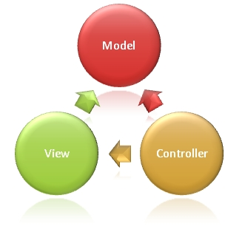
Model View Controller (MVC)
represents the application core (the business logic layer)
To display the data (the display/view layer)
To handle input (the input control layer)
Notes:
The Model represents the application core (for instance a list of database records, e.g. car record (most of the time, we call it a class).
The View displays the data (the database records on the web page).
The Controller handles the input (to the Model, and Model will then save the record to the database).

Slide 9
ASP.NET MVC
MVC is a framework for building web applications using a MVC (Model View Controller) design.
Visual Web Developer is a development tool tailor made for ASP.NET MVC (and Web Forms).
Notes:
Visual Web Developer is the free version of Microsoft Visual Studio.

Slide 10
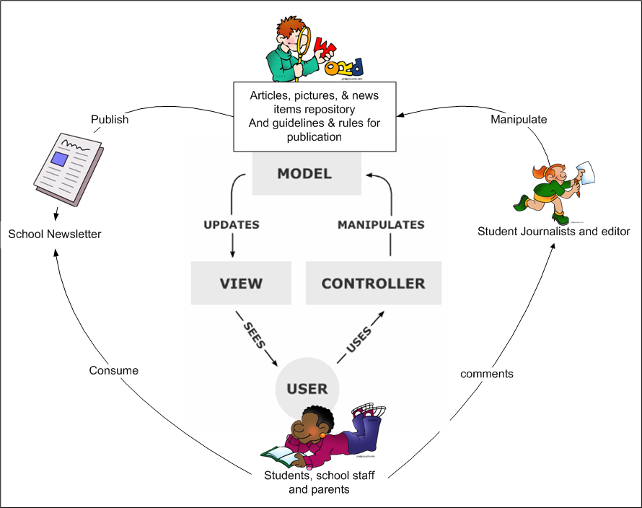
Model-view-controller - concept

Slide 11
ASP.NET Web Forms
The traditional ASP.NET and oldest event-driven development model
Web pages with added server controls, server events, and server code.

Slide 12
ASP.NET Web Forms
refers to the grouping of two distinct blocks of code:
HTML template – presentation of the Web form on the browser.
ASP.NET code – holds a script containing the Web form's processing logic.

Slide 13
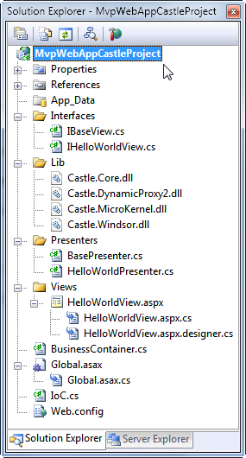

Web Forms (Physical view)
Static HTML + Server controls
Presentation Layer
server code in C# (also known as code-behind)
To create dynamic content
Notes:
You can add more than 50 standard ASP.NET controls to your Web Forms Pages.

Slide 14
Web Form Syntax in the Presentation Layer
<body>
<form ID="MyForm" runat="server">
... here we place the server controls...
</form>
</body>

Slide 15
Benefits of ASP.NET Server Controls
Intuitive object model
Expose the HTML elements of a page in an intuitive object model.
Automatically retain the value of their properties by participating in view state.
Enable view state
Separate design from logic
Enable you to cleanly separate the design content of a page from the application logic.
Browser compatibility
Enable you to maintain browser compatibility while still supporting advanced browser features.
Notes:
http://stackoverflow.com/questions/2698186/why-do-some-asp-net-controls-keep-its-state-although-its-enableviewstate-propert
https://blogs.msdn.microsoft.com/asgoyal/2012/08/29/asp-net-view-state-enableviewstate-vs-viewstatemode/

Slide 16
Server Controls and HTML Tags
ASP.NET Web Control
Similar HTML Form Tag
<asp:Label>
<Span>, <Div>
<asp:ListBox>
<Select>
<asp:DropDownList>
<Select>
<asp:TextBox>
<Input Type="Text">
<asp:RadioButton> and
<asp:RadioButtonList>
<Input Type="Radio">
<asp:CheckBox> and
<asp:CheckBoxList>
<Input Type="CheckBox">
<asp:Button>
<Input Type="submit">

Slide 17
HTML control, HTML Server control and Server control
 | HTML Control | Server Control
 | <input type=“text” /> | <asp:TextBox ID=“txtName” runat=“server” />
Processed by whom? | By web browser | By server
Why use it? | Basic control rendering and client-side scripting | Allows server to intervene and process. Enables view state which allows value to be retain even after page is refreshed. Circumvent browser compatibility issue.
Limitations | Need to consider browser compatibility | Must be processed by a server
Notes:
HTML – processed by browser. Server control – processed by server.
HTML – used to deal with client-side scripting (e.g. JavaScript). Server control – there are many complex controls, such as calendar, validation controls etc, with more functionality. Server control also enables view state, which allows value to be retained despite the page is refreshed. No need to worry about browser compatibility issue.
HTML control – need to code based on browser compatibility (not all browsers support JavaScript. Server control – Must be processed by server first.
Extra:
HTML – processed by browser. HTML server control – processed by client and server (depending on the code). Server control – processed by server.
HTML – used to deal with client-side scripting (e.g. JavaScript). HTML server control – migration from client page to server page is easier. Server control – there are many complex controls, such as calendar, validation controls etc, with more functionality. Server control also enables view state, which allows value to be retained despite the page is refreshed. No need to worry about browser compatibility issue.
HTML control – need to code based on browser compatibility (not all browsers support JavaScript) HTML server control - need to code based on browser compatibility. Server control – Must be processed by server first.

Slide 18
ASP.NET Server Controls Syntax
All server controls must have two attributes
runat and ID
E.g.:
<asp:Label id="lblMyLabel" runat="server">Sale Ends May 2nd</asp:Label>

Slide 19
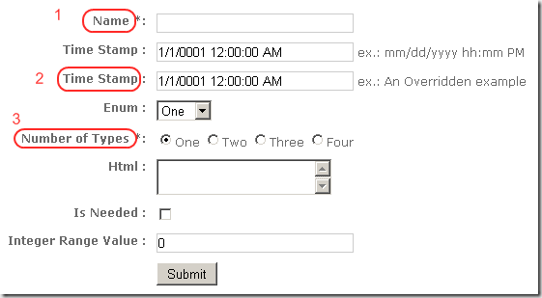
Example with Code
CheckBox or CheckBoxList?
<asp:RadioButtonList id="radType" runat="server">
<asp:ListItem value="One"/>
<asp:ListItem value=“Two"/>
<asp:ListItem value=“Three"/>
<asp:ListItem value=“Four"/>
</asp:RadioButtonList>
<asp:Label ID="lblName" runat="server">Name *:</asp:Label>
<asp:DropDownList id="lstEnum" runat="server"> <asp:ListItem>One</asp:ListItem>
<asp:ListItem>Two</asp:ListItem>
</asp:DropDownList >
<asp:TextBox id= "txtHtml" rows= "2" TextMode= "MultiLine" runat="server" />
<asp:TextBox ID=“txtName" runat="server"></asp:TextBox>
<asp:TextBox id="txtValue" runat="server" Text="0"/>

Slide 20
Questions
Suggest appropriate ASP.NET server controls that you should use in order to obtain the following data from a user:
Name
Gender
Address
Date of birth
Favourite TV Channel

Slide 21
Site Design
Master Page and Site Map

Slide 22
Creating a Consistent Look and Feel Site
A site benefits from a consistent look and feel, which generally includes the following:
A common header and menu system for the entire site.
A bar on the left side of the page offering some page navigation options.
A footer providing copyright information and a secondary menu for contacting the webmaster.

Slide 23
Creating a Consistent Look and Feel Site
Master Pages
defines the layout to be used by all pages based on the Master.
Essential elements (e.g. Header, menu) will be presented on every page

Slide 24
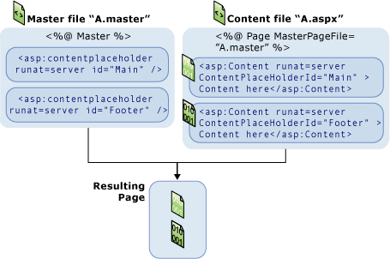
ASP.NET Master Page

Slide 25
Advantages of Master Page
Easy to create
You simply apply the same Master Page to the new content page.
Easy to maintain
If you decide to completely modify the design of your website, you can modify just a single Master Page to change the appearance of all the pages in your application.

Slide 26
Provide clear navigation mechanisms
orientation information, navigation bars, a site map, etc. should be provided
to increase the likelihood that a person will find what they are looking for at a site.

Slide 27
Site Map
It is an overview of the pages within a website.
It is a list of pages of a web site accessible to Web crawlers or users
This allows visitors to quickly jump to any section of a website listed in the site map.
This also gives visitors a good overall picture of how the site is organized and clearly defines all the resources the website has to offer

Slide 28
Designing a Site Map
site maps can be organized in a variety of ways. Typically organized in hierarchical fashion, most use an outline form, with pages arranged by topic.
Can include pages for major categories and subcategories of the website

Slide 29
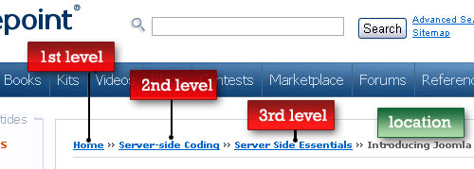
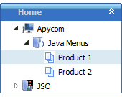
ASP.NET Site Map
ASP.NET holds this information in an XML file named Web.sitemap. This file is used as the source of data for menu and navigation controls.
Navigation controls that can use together with site map:
TreeView
SiteMapPath (breadcrumbs)
Menu
Default XML Site Map file name

Slide 30
ASP.NET Site Map - Code
<?xml version="1.0" encoding="ISO-8859-1" ?> <siteMap>
<siteMapNode title="Home" url="/aspnet/w3home.aspx"> <siteMapNode title="Services"> <siteMapNode title="Training" url="/aspnet/training.aspx"/> <siteMapNode title="Support" url="/aspnet/support.aspx" description="Online support" /> </siteMapNode> </siteMapNode> </siteMap>
Main node (first level)
First Category: Services (2nd level)
Child nodes under “Services” (3rd level)
Notes:
Home
Services
Training
Support

Slide 31
ASP.NET Site Map - Code
Explanation of the three main attributes of <siteMapNode>:
title : The title to be displayed
Description: A longer description that associates with a node. It is the tooltip that will appears when you hover the node.
url : A URL that points to a page or other resource. Include this if you want it to be a hyperlink

Slide 32
ASP.NET Site Map - Code
Therefore the output of the code:
Remark: Underline the text if it is a hyperlink

Slide 33
Question
Write the Code in the web.sitemap for the following structure:
Home [Default.aspx ]
Products
Health Care [healthcare.aspx]
Sports [sports.aspx]
Services
Contact Us [contact.aspx]
Redemption [redemption.aspx]
This shows a tooltip “contact your nearest store”
This shows a tooltip “gift redemption”

Slide 34
Question
Identify 2 different errors of the code below:
<?xml version="1.0" encoding="ISO-8859-1" ?> <siteMap> <siteMapNode title=“Product" url= "" >
<siteMapNode title=“Health Care" url=“healthcare.aspx "> <siteMapNode title=“Supplements" url=“supplements.aspx" >
</siteMapNode> <siteMapNode title="Services"> <siteMapNode title="Training" url="training.aspx " > <siteMapNode title="Support" url=“support.aspx" > </siteMapNode> </siteMap>

Slide 35
DEMO
Site Map: Site Map structure

Slide 36
Next Week
Event-driven Programming
Page Event
Server Control Event

